Slide 1


UNIVERSITY OF ENGINEERING & MANAGEMENT, KOLKATA
Course Name : AI & ML

Slide 2
 | UNIVERSITY OF ENGINEERING & MANAGEMENT, KOLKATA
Prime considerations of Problem Solving:-
Represent the problem as proper state space;
Identify goal state and determine optimal path from starting state to goal state;
Search problem is related to two facts “ what to search” and “where to search”

Slide 3
 | UNIVERSITY OF ENGINEERING & MANAGEMENT, KOLKATA
Search Algorithm Terminologies:
Search: Searching is a step by step procedure to solve a search-problem in a given search space. A search problem can have three main factors:
  Search Space: Search space represents a set of possible solutions, which a system may have.
  Start State: It is a state from where agent begins the search.
  Goal test: It is a function which observe the current state and returns whether the goal state is achieved or not.
Search tree: A tree representation of search problem is called Search tree. The root of the search tree is the root node which is corresponding to the initial state.
Actions: It gives the description of all the available actions to the agent.
Transition model: A description of what each action do, can be represented as a transition model.
Path Cost: It is a function which assigns a numeric cost to each path.
Solution: It is an action sequence which leads from the start node to the goal node.
Optimal Solution: If a solution has the lowest cost among all solutions.

Slide 4
 | UNIVERSITY OF ENGINEERING & MANAGEMENT, KOLKATA
Properties of Search Algorithms:
Completeness: A search algorithm is said to be complete if it guarantees to return a solution if at least a solution exists for any random input.
Optimality: If a solution found for an algorithm is guaranteed to be the best solution (lowest path cost) among all other solutions, then such a solution for is said to be an optimal solution.
Time Complexity: Time complexity is a measure of time for an algorithm to complete its task.
Space Complexity: It is the maximum storage space required at any point during the search, as the complexity of the problem.

Slide 5
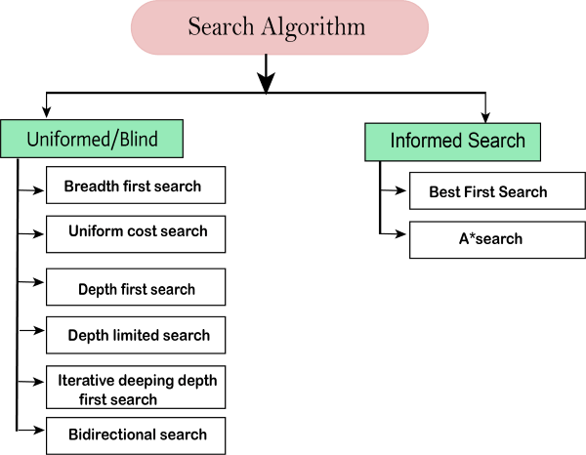
 | UNIVERSITY OF ENGINEERING & MANAGEMENT, KOLKATA

Slide 6
 | UNIVERSITY OF ENGINEERING & MANAGEMENT, KOLKATA
Uninformed/Blind Search:
The uninformed search does not contain any domain knowledge such as closeness, the location of the goal.
It operates in a brute-force way as it only includes information about how to traverse the tree and how to identify leaf and goal nodes.
Uninformed search applies a way in which search tree is searched without any information about the search space like initial state operators and test for the goal, so it is also called blind search. It examines each node of the tree until it achieves the goal node.
Informed Search
Informed search algorithms use domain knowledge. In an informed search, problem information is available which can guide the search.
Informed search strategies can find a solution more efficiently than an uninformed search strategy.
Informed search is also called a Heuristic search.

Slide 7
 | UNIVERSITY OF ENGINEERING & MANAGEMENT, KOLKATA
Different Approaches:-
Generate & Test [ BFS, DFS, Hill-Climbing, Simulated Annealing]
Heuristic Search [Best-First-Search, A*, AO*]
Adversary Search [MINIMAX Algorithm, Alpha-Beta Cutoff]

Slide 8
 | UNIVERSITY OF ENGINEERING & MANAGEMENT, KOLKATA
Procedure Generate & Test
Begin
Repeat
Generate a new state and call it current-state;
Until current-state = Goal;
End.

Slide 9
 | UNIVERSITY OF ENGINEERING & MANAGEMENT, KOLKATA
Procedure Breadth-first-search
Begin
i) Place the starting node in a queue;
ii) Repeat
Delete queue to get the front element;
If the front element of the queue = goal, return success and stop;
Else do
Begin
insert the children of the front element, if exist, in any order at the rear end of the queue;
End
Until the queue is empty;
End.

Slide 10
 | UNIVERSITY OF ENGINEERING & MANAGEMENT, KOLKATA
Procedure Depth first search
Begin
1. Push the starting node at the stack, pointed to by the stack-top;
2. While stack is not empty do
Begin
Pop stack to get stack-top element;
If stack-top element = goal, return success and stop
Else push the children of the stack-top element in any order into the stack;
End while;
End.

Slide 11
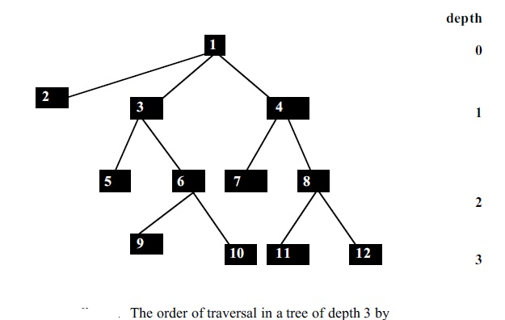
 | UNIVERSITY OF ENGINEERING & MANAGEMENT, KOLKATA

Slide 12
 | UNIVERSITY OF ENGINEERING & MANAGEMENT, KOLKATA
Procedure Iterative-deepening
Begin
1. Set current depth cutoff =1;
2. Put the initial node into a stack, pointed to by stack-top;
3. While the stack is not empty and the depth is within the given depth cut-off do
Begin
Pop stack to get the stack-top element;
if stack-top element = goal, return it and stop
else push the children of the stack-top in any order into the stack;
End While;
4. Increment the depth cut-off by 1 and repeat
through step 2;
End.

Slide 13
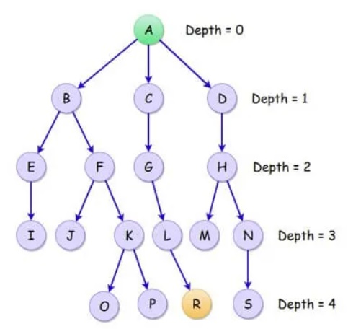
 | UNIVERSITY OF ENGINEERING & MANAGEMENT, KOLKATA

Slide 14
 | UNIVERSITY OF ENGINEERING & MANAGEMENT, KOLKATA
Procedure Hill-Climbing
Begin
1. Identify possible starting states and measure the distance (f) of their closeness with the goal node; Push them in a stack according to the ascending order of their f ;
2. Repeat
Pop stack to get the stack-top element;
If the stack-top element is the goal, announce it and exit
Else push its children into the stack in the ascending order of their f values;
Until the stack is empty;
End.

Slide 15
 | UNIVERSITY OF ENGINEERING & MANAGEMENT, KOLKATA
Initial | Goal
A | H
H | G
G | F
F | E
E | D
D | C
C | B
B | A
Add 1 point for correct resting position and subtract 1 point for wrong resting position.

Slide 16
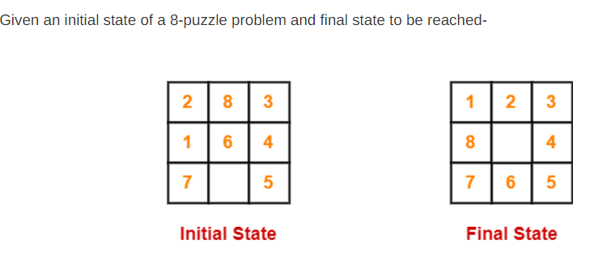
 | UNIVERSITY OF ENGINEERING & MANAGEMENT, KOLKATA

Slide 17
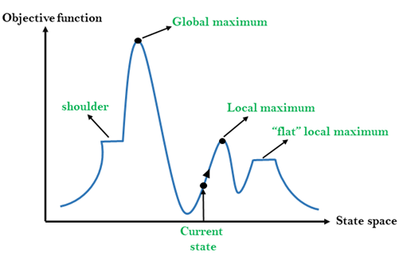
 | UNIVERSITY OF ENGINEERING & MANAGEMENT, KOLKATA

Slide 18
 | UNIVERSITY OF ENGINEERING & MANAGEMENT, KOLKATA
Problems in different regions in Hill climbing
Hill climbing cannot reach the optimal/best state(global maximum) if it enters any of the following regions :
Local maximum: At a local maximum all neighboring states have a value that is worse than the current state. Since hill-climbing uses a greedy approach, it will not move to the worse state and terminate itself. The process will end even though a better solution may exist.
To overcome the local maximum problem: Utilize the backtracking technique. Maintain a list of visited states. If the search reaches an undesirable state, it can backtrack to the previous configuration and explore a new path.
Plateau: On the plateau, all neighbors have the same value. Hence, it is not possible to select the best direction. To overcome plateaus: Make a big jump. Randomly select a state far away from the current state. Chances are that we will land in a non-plateau region.
Ridge: Any point on a ridge can look like a peak because movement in all possible directions is downward. Hence the algorithm stops when it reaches this state.
To overcome Ridge: In this kind of obstacle, use two or more rules before testing. It implies moving in several directions at once

Slide 19
 | UNIVERSITY OF ENGINEERING & MANAGEMENT, KOLKATA
Procedure Simulated Annealing
Begin
1. Identify possible starting states and measure the distance (f) of their closeness with the goal; Push them in a stack according to the
ascending order of their f ;
2. Repeat
Pop stack to get stack-top element;
If the stack-top element is the goal,
announce it and exit;
Else do
Begin
a) generate children of the stack-top element N and compute f for each of them;
b) If measure of f for at least one child of N is improving

Slide 20
 | UNIVERSITY OF ENGINEERING & MANAGEMENT, KOLKATA
Then push those children into stack in ascending order of their f;
c) If none of the children of N is better in f
Then do
Begin
a) select any one of them randomly, compute its p’ and test
whether p’ exceeds a randomly generated number in the interval [0,1]; If yes, select that state as the next state; If no, generate another alternative legal next state and test in this way until one move can be selected; Replace stack-top element by the selected move (state);
[p’ = exp (-∆E / T)]
b) Reduce T slightly; If the reduced value is negative, set it to zero;
End;
Until the stack is empty;
End.

Slide 21
 | UNIVERSITY OF ENGINEERING & MANAGEMENT, KOLKATA
Concept of Heuristic Search
The term “heuristics” stands for “ thumb rules”, i.e., rules which work successfully in many cases but its success is not guaranteed.
Heuristic search is generally employed for two distinct types of problems: i) forward reasoning (ex: OR graph or Best first search, A*) and ii) backward reasoning ( ex: AND-OR graph or AO* )

Slide 22
 | UNIVERSITY OF ENGINEERING & MANAGEMENT, KOLKATA
Procedure Best-First-Search
Begin
1. Identify possible starting states and measure the distance (f) of their
closeness with the goal; Put them in a list L;
2. While L is not empty do
Begin
a) Identify the node n from L that has the minimum f; If there exist more than one node with minimum f, select any one of them (say, n) arbitrarily;
b) If n is the goal
Then return n along with the path from the starting node, and exit;
Else remove n from L and add all the children of n to the list L, with their labeled paths from the starting node;
End While;
End.

Slide 23
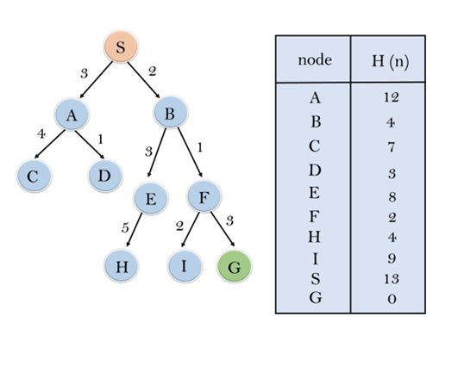
 | UNIVERSITY OF ENGINEERING & MANAGEMENT, KOLKATA

Slide 24
 | UNIVERSITY OF ENGINEERING & MANAGEMENT, KOLKATA
Few important concepts:
A node is called open if the node has been generated and the h’ (x) has been applied over it but it has not been expanded yet.
A node is called closed if it has been expanded for generating off springs.
The heuristic cost measures the distance of the current node x with respect to the goal and is denoted by h(x).
The cost of generating a node x, denoted by g(x), on the other hand measures the distance of node x with respect to the starting node in the graph.
The total cost function at node x, denoted by f(x), is the sum of g(x) plus h(x).

Slide 25
 | UNIVERSITY OF ENGINEERING & MANAGEMENT, KOLKATA
Procedure A*
Begin
1. Put a new node n to the set of open nodes (here after open); Measure its f’(n) = g(n) + h’ (n); Presume the set of closed nodes to be a null set
initially;
2. While open is not empty do
Begin
If n is the goal, stop and return n and the path of n from the beginning node to n through back pointers;
Else do
Begin
a) remove n from open and put it under closed;
b) generate the children of n;
c) If all of them are new (i.e., do not exist in the graph before generating them Then add them to open and label their f’ and the path from the root node through back pointers;

Slide 26
 | UNIVERSITY OF ENGINEERING & MANAGEMENT, KOLKATA
d) If one or more children of n already existed as open nodes in the graph before their generation Then those children must have multiple parents; Under this circumstance compute their f’ through current path and
compare it through their old paths, and keep them connected only through the shortest path from the starting node and label the back pointer from the children of n to their parent, if such pointers do not exist;
e) If one or more children of n already existed as closed nodes before generation of them, then they too must have multiple parents; Under this circumstance, find the shortest path from the starting node, i.e., the path (may be current or old) through which f’ of n is minimum; If the current path is selected, then the nodes in the sub-tree rooted at the corresponding child of n should have revised f’ as the g’ for many of the nodes in that sub-tree changed; Label the back pointer from the children of n to their parent, if such pointers do not exist;
End;
End While;
End.

Slide 27
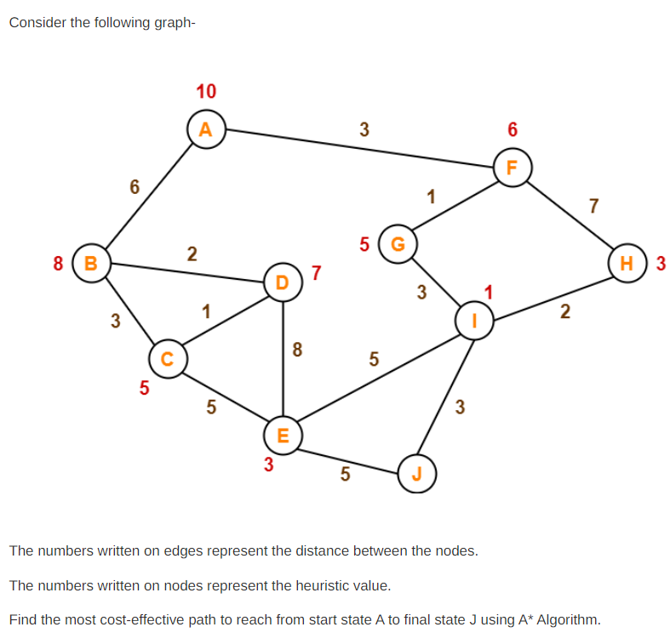
 | UNIVERSITY OF ENGINEERING & MANAGEMENT, KOLKATA

Slide 28
 | UNIVERSITY OF ENGINEERING & MANAGEMENT, KOLKATA
AO* algorithm are presented below:
1. Given the Goal node, hereafter called the starting state, find the possible offsprings of the starting state, such that the Goal can be derived from them by AND / OR clauses.
2. Estimate the h’ values at the leaves and find the leaf (leaves) with minimum h’. The cost of the parent of the leaf (leaves) is the minimum of the cost of the OR clauses plus one or the cost of the AND clauses plus the number of AND clauses. After the children with minimum h’ are estimated, a pointer is attached to point from the parent node to its promising children.
3. One of the unexpanded OR clauses / the set of unexpanded AND clauses, where the pointer points from its parent, is now expanded and the h’ of the newly generated children are estimated. The effect of this h’ has to be propagated up to the root by re-calculating the f’ of the parent or the parent of the parents of the newly created child / children clauses through a least cost path. Thus the pointers may be modified depending on the revised cost of the existing clauses.

Slide 29
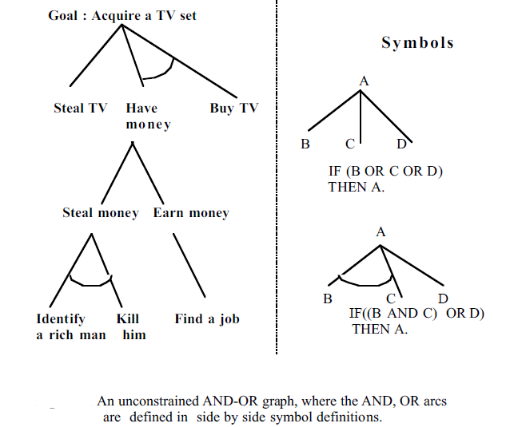
 | UNIVERSITY OF ENGINEERING & MANAGEMENT, KOLKATA

Slide 30
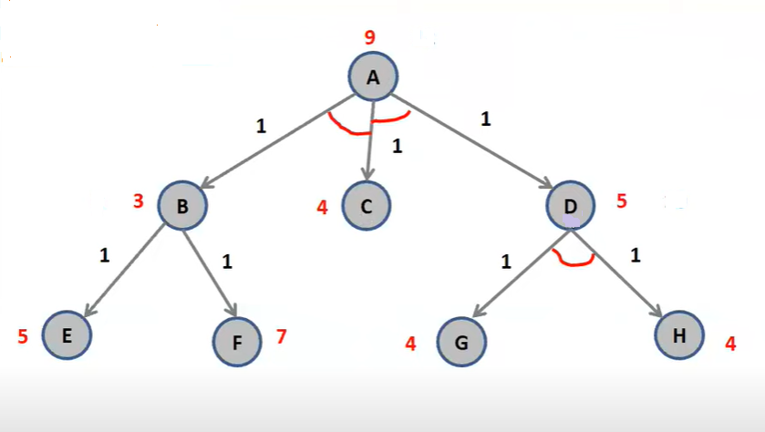
 | UNIVERSITY OF ENGINEERING & MANAGEMENT, KOLKATA

Slide 31
 | UNIVERSITY OF ENGINEERING & MANAGEMENT, KOLKATA
Procedure AO*
Begin
1. Given the goal node INIT in the graph G; evaluate h’ at INIT;
2. Repeat
(a)Trace the marked arcs from the node INIT, if any such exists, and select one of the unexpanded nodes, named NODE, that occurs on this path, for expansion.
(b) If NODE cannot be expanded, Then assign FUTILITY as the h’ value of NODE, indicating that NODE is not solvable;
Else for each such successor, called SUCCESSOR, which is not an ancestor of NODE, do
Begin
(i) Append SUCCESSOR to the graph G.
(ii) If SUCCESSOR is a terminal node Then label it SOLVED and set its h’ value 0.
(iii) If SUCCESSOR is not a terminal node Then estimate its h’ value;
End;

Slide 32
 | UNIVERSITY OF ENGINEERING & MANAGEMENT, KOLKATA
c) Initialize S to NODE;
(d) Repeat
(i) Select from S a node, none of whose descendants belong to S. Call it CURRENT and remove it from S.
(ii) Estimate the cost of each of the arcs, emerging from CURRENT. The cost of each arc is equal to the sum of h’ value of each of the nodes at the end of the arc plus the cost of the arc itself. The new h’ value of CURRENT is the minimum of the cost just computed for the arcs emerging from it.
(iii) Label the best path out of CURRENT by marking the arc that had the least cost as computed in the last step. (iv) If all of the nodes connected to CURRENT through the new
marked arcs have been labeled SOLVED, Then mark the
CURRENT SOLVED.
(v) If CURRENT is marked SOLVED or the cost of CURRENT was changed, Then propagate its new status back up the tree, add all the ancestors of CURRENT to S.
Until S is empty.
Until INIT is labeled solved or its h’ value becomes greater than a maximum level called FUTILITY:
End.

Slide 33
 | UNIVERSITY OF ENGINEERING & MANAGEMENT, KOLKATA
Adversary Search
Adversarial search is a game playing technique where the agents are surrounded by a competitive environment.
A conflicting goal is given to the agents (multi-agent). These agents compete with one another and try to defeat one another in order to win the game. Such conflicting goals give rise to the adversarial search.

Slide 34
 | UNIVERSITY OF ENGINEERING & MANAGEMENT, KOLKATA
Procedure MINIMAX
Begin
1. Expand the entire state-space below the starting node;
2. Assign values to the terminals of the state-space from -1,0,+1}, depending on the success of the MINIMIZER, draw, or the success of the MAXIMIZER respectively;
3. For each node whose all children possess values, do
if it is a MAXIMIZER node, then its value will be maximum of its childrens’ value; if it is a MINIMIZER node, then its value will be the minimum of its children;
End For;
End

Slide 35
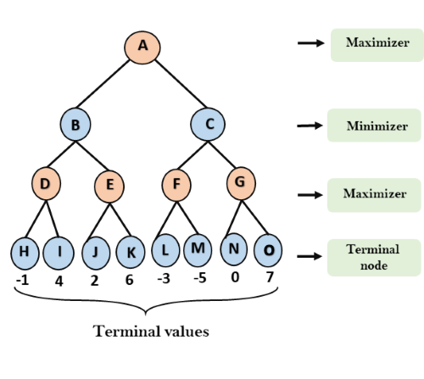
 | UNIVERSITY OF ENGINEERING & MANAGEMENT, KOLKATA

Slide 36
 | UNIVERSITY OF ENGINEERING & MANAGEMENT, KOLKATA
Key points in Alpha-beta Pruning
Alpha: Alpha is the best choice or the highest value that we have found at any instance along the path of Maximizer. The initial value for alpha is – ∞.
Beta: Beta is the best choice or the lowest value that we have found at any instance along the path of Minimizer. The initial value for alpha is + ∞.
The condition for Alpha-beta Pruning is that α >= β.
Each node has to keep track of its alpha and beta values. Alpha can be updated only when it’s MAX’s turn and, similarly, beta can be updated only when it’s MIN’s chance.
MAX will update only alpha values and MIN player will update only beta values.
The node values will be passed to upper nodes instead of values of alpha and beta during go into reverse of tree.
Alpha and Beta values only be passed to child nodes.

Slide 37
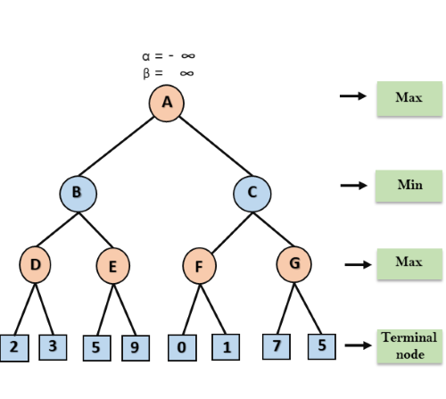
 | UNIVERSITY OF ENGINEERING & MANAGEMENT, KOLKATA
At the first step the, Max player will start first move from node A where α= -∞ and β= +∞, these value of alpha and beta passed down to node B where again α= -∞ and β= +∞, and Node B passes the same value to its child D.

Slide 38
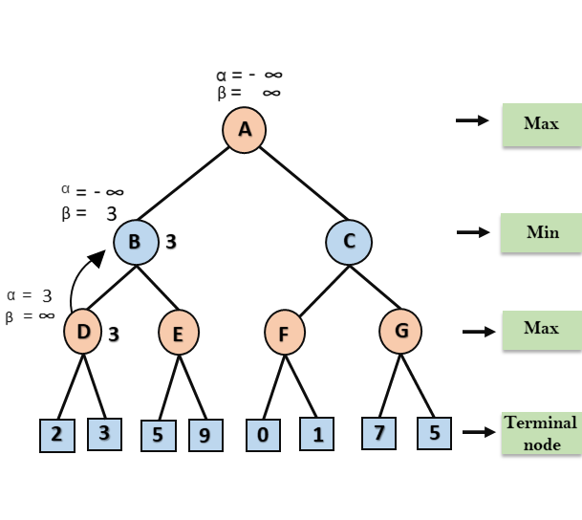
 | UNIVERSITY OF ENGINEERING & MANAGEMENT, KOLKATA
At Node D, the value of α will be calculated as its turn for Max. The value of α is compared with firstly 2 and then 3, and the max (2, 3) = 3 will be the value of α at node D and node value will also 3.
Now algorithm backtrack to node B, where the value of β will change as this is a turn of Min, Now β= +∞, will compare with the available subsequent nodes value, i.e. min (∞, 3) = 3, hence at node B now α= -∞, and β= 3.

Slide 39
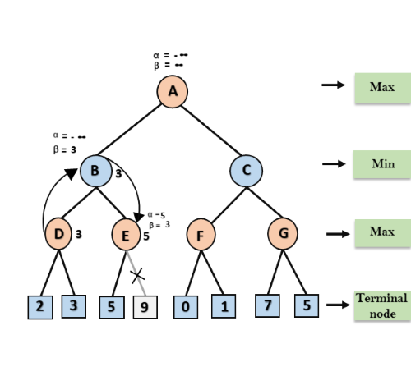
 | UNIVERSITY OF ENGINEERING & MANAGEMENT, KOLKATA
At node E, Max will take its turn, and the value of alpha will change. The current value of alpha will be compared with 5, so max (-∞, 5) = 5, hence at node E α= 5 and β= 3, where α>=β, so the right successor of E will be pruned, and algorithm will not traverse it, and the value at node E will be 5.

Slide 40
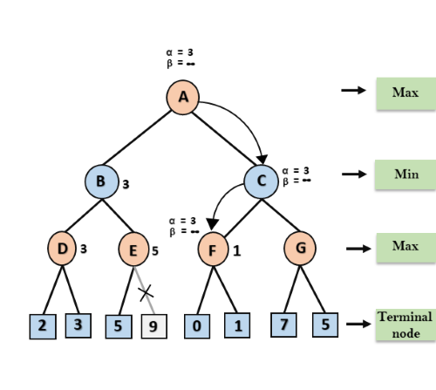
 | UNIVERSITY OF ENGINEERING & MANAGEMENT, KOLKATA
At next step, algorithm again backtrack the tree, from node B to node A. At node A, the value of alpha will be changed the maximum available value is 3 as max (-∞, 3)= 3, and β= +∞, these two values now passes to right successor of A which is Node C.
At node C, α=3 and β= +∞, and the same values will be passed on to node F.
At node F, again the value of α will be compared with left child which is 0, and max(3,0)= 3, and then compared with right child which is 1, and max(3,1)= 3 still α remains 3, but the node value of F will become 1.

Slide 41
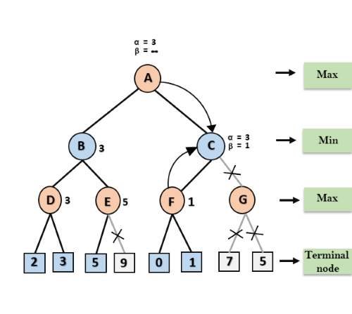
 | UNIVERSITY OF ENGINEERING & MANAGEMENT, KOLKATA
Node F returns the node value 1 to node C, at C α= 3 and β= +∞, here the value of beta will be changed, it will compare with 1 so min (∞, 1) = 1. Now at C, α=3 and β= 1, and again it satisfies the condition α>=β, so the next child of C which is G will be pruned, and the algorithm will not compute the entire sub-tree G.

Slide 42
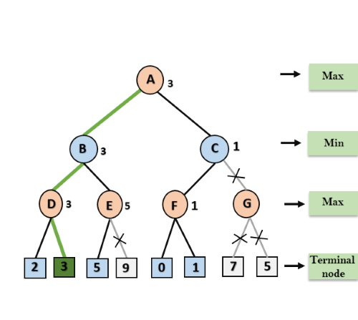
 | UNIVERSITY OF ENGINEERING & MANAGEMENT, KOLKATA
C now returns the value of 1 to A here the best value for A is max (3, 1) = 3. Following is the final game tree which is the showing the nodes which are computed and nodes which has never computed. Hence the optimal value for the maximizer is 3 for this example.

Slide 43

 | UNIVERSITY OF ENGINEERING & MANAGEMENT, KOLKATA
Thank You

